Slide 1
Lecture10

Slide 2
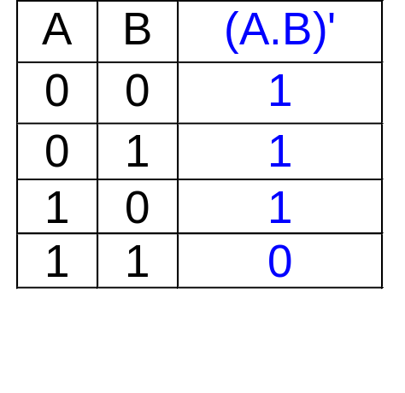
Logic Gates: The NAND Gate
The NAND Gate
A
B
≡
A
B
(A.B)'
(A.B)'
≡
NAND
Negative-OR

Slide 3
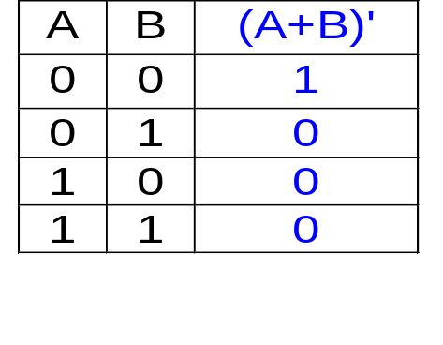
Logic Gates: The NOR Gate
The NOR Gate
A
B
≡
A
B
(A+B)'
(A+B)'
≡
NOR
Negative-AND

Slide 4
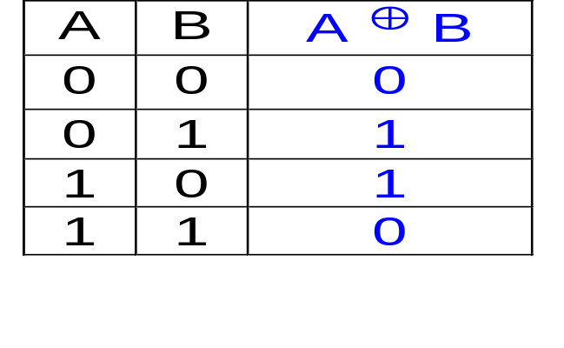
Logic Gates: The XOR Gate
The XOR Gate
A
B
A ⊕ B

Slide 5
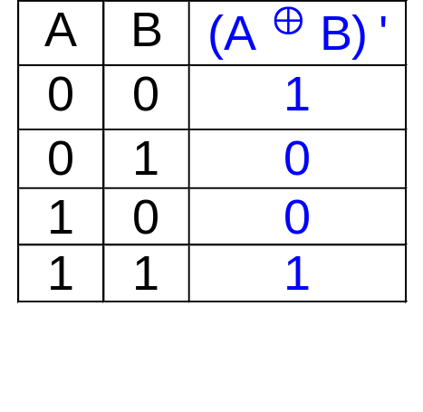
Logic Gates: The XNOR Gate
The XNOR Gate
A
B
(A ⊕ B)'

Slide 6
Drawing Logic Circuit
When a Boolean expression is provided, we can easily draw the logic circuit.
Examples:
(i) F1 = xyz' (note the use of a 3-input AND gate)
x
y
F1
z
z'

Slide 7
Drawing Logic Circuit
F2 = x + y'z (can assume that variables and their complements are available)
x
F2
y'
z
y'z
(iii) F3 = xy' + x'z
x
xy'
y'
F3
x'
z
x'z

Slide 8
Analysing Logic Circuit
When a logic circuit is provided, we can analyse the circuit to obtain the logic expression.
Example: What is the Boolean expression of F4?
A'
B'
C
F4

Slide 9
Universal Gates: NAND and NOR
AND/OR/NOT gates are sufficient for building any Boolean functions.
We call the set {AND, OR, NOT} a complete set of logic.
However, other gates are also used because:
(i) usefulness
(ii) economical on transistors
(iii) self-sufficient
NAND/NOR: economical, self-sufficient
XOR: useful (e.g. parity bit generation)

Slide 10
NAND Gate
NAND gate is self-sufficient (can build any logic circuit with it).
Therefore, {NAND} is also a complete set of logic.
Can be used to implement AND/OR/NOT.
Implementing an inverter using NAND gate:
x
x'
(x.x)' = x' (T1: idempotency)

Slide 11
NAND Gate
Implementing AND using NAND gates:
(x.y)'
x
x.y
((xy)'(xy)')' = ((xy)')' idempotency
= (xy) involution
y
Implementing OR using NAND gates:
x'
((xx)'(yy)')' = (x'y')' idempotency
= x''+y'' DeMorgan
= x+y involution
x
x+y
y
y'

Slide 12
NOR Gate
NOR gate is also self-sufficient.
Therefore, {NOR} is also a complete set of logic
Can be used to implement AND/OR/NOT.
Implementing an inverter using NOR gate:
x
x'
(x+x)' = x' (T1: idempotency)

Slide 13
NOR Gate
Implementing AND using NOR gates:
x'
x
((x+x)'+(y+y)')'=(x'+y')' idempotency
= x''.y'' DeMorgan
= x.y involution
x.y
y
y'
Implementing OR using NOR gates:
(x+y)'
((x+y)'+(x+y)')' = ((x+y)')' idempotency
= (x+y) involution
x
x+y
y

Slide 14
Implementation using NAND gates
Possible to implement any Boolean expression using NAND gates.
Procedure:
(i) Obtain sum-of-products Boolean expression:
e.g. F3 = xy'+x'z
(ii) Use DeMorgan theorem to obtain expression using 2-level NAND gates
e.g. F3 = xy'+x'z
= (xy'+x'z)' ' involution
= ((xy')' . (x'z)')' DeMorgan

Slide 15
Implementation using NAND gates
F3 = ((xy')'.(x'z)') ' = xy' + x'z
x
(xy')'
y'
F3
x'
z
(x'z)'

Slide 16
Implementation using NOR gates
Possible to implement any Boolean expression using NOR gates.
Procedure:
(i) Obtain product-of-sums Boolean expression:
e.g. F6 = (x+y').(x'+z)
(ii) Use DeMorgan theorem to obtain expression using 2-level NOR gates.
e.g. F6 = (x+y').(x'+z)
= ((x+y').(x'+z))' ' involution
= ((x+y')'+(x'+z)')' DeMorgan

Slide 17
Implementation using NOR gates
x
(x+y')'
y'
F6
x'
z
(x'+z)'
F6 = ((x+y')'+(x'+z)')' = (x+y').(x'+z)

Slide 18
Implementation of SOP Expressions
Sum-of-Products expressions can be implemented using:
  2-level AND-OR logic circuits
  2-level NAND logic circuits
AND-OR logic circuit
A
B
C
F
= AB + CD + E
D
E

Slide 19
Implementation of SOP Expressions
NAND-NAND circuit (by circuit transformation)
a) add double bubbles
b) change OR-with-
inverted-inputs to NAND
& bubbles at inputs to
their complements
A
B
C
F
D
E
A
B
C
F
D
E'

Slide 20
Implementation of POS Expressions
Product-of-Sums expressions can be implemented using:
  2-level OR-AND logic circuits
  2-level NOR logic circuits
OR-AND logic circuit
G = (A+B).(C+D).E
A
B
C
D
G
=(A+B).(C+D).E
E

Slide 21
Implementation of POS Expressions
NOR-NOR circuit (by circuit transformation):
a) add double bubbles
b) changed AND-with-
inverted-inputs to NOR
& bubbles at inputs to
their complements
A
B
C
D
G
E
A
B
C
D
G
E'

